Slide 1
Chapter 4
Synchronization

Slide 2
Physical clocks:
Execution time
Resource time
Distributed environment: Each CPU has its own clock. Synchronization required.
Global clock?
Example problems with unsynchronized clocks:
Sequence of events

Slide 3
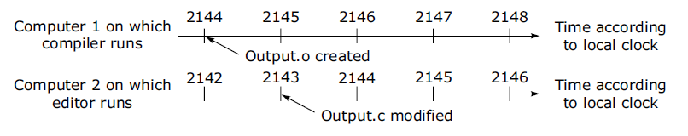
Clock Synchronization
Figure 6-1. When each machine has its own clock, an event that occurred after another event may nevertheless be assigned an earlier time.

Slide 4
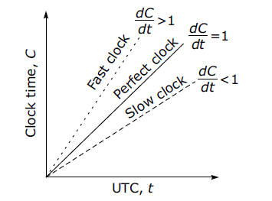
Physical Clocks
Implementing computer clocks
Crystal
Counter Register
Holding Register
Interrupt handler
Drifting of Computer Clocks: Differences of crystals
C=Current time t= Real time
Issues in Clock Synchronization
Ability for each node to read the other node’s clock value
Time must never run backwards

Slide 5
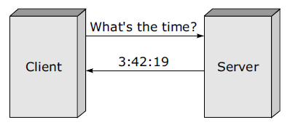
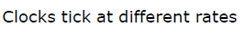
Simple Clock Synchronization

Slide 6
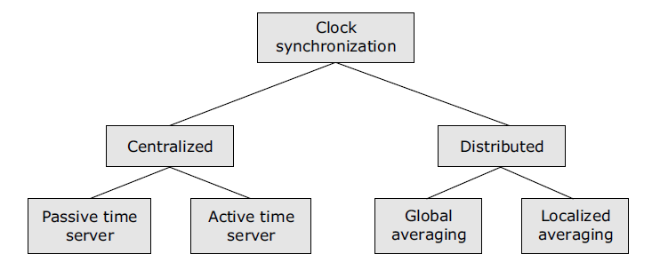
Clock Synchronization

Slide 7
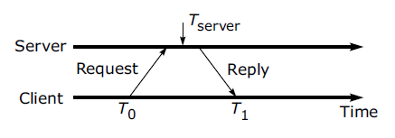
Centralized Algorithms-1
Passive time server
Tnew = Tserver+(T1-T0)/2

Slide 8
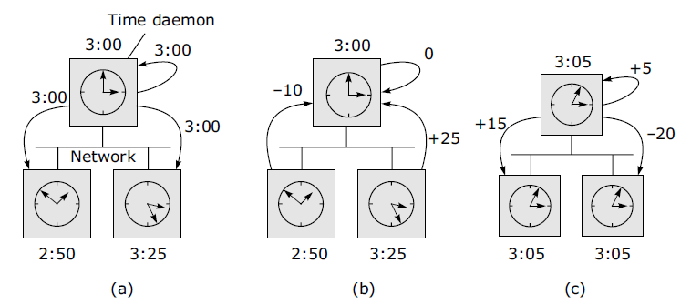
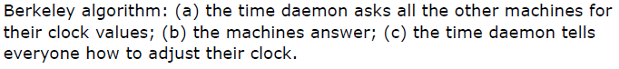
Active Time Server Centralized Algorithm
Server timely broadcasts Time =T and propagation time is known
Drawbacks: broadcast, wrong clock adjustment because of network delay
Berkeley algorithm:
Drawbacks:
single point of failure
Not capable of servicing all requests

Slide 9
Distributed Algorithms
Characteristics
Relevant information is distributed across machines
Processes make decisions based only on local information
Single points of failure must be avoided
No common or global clock is available
Logical clocks:
Clock synchronization is not possible
Lamport algorithm: Not required to keep all clocks synchronized.
But
Ensure that all events are totally ordered.
Happened before

Slide 10
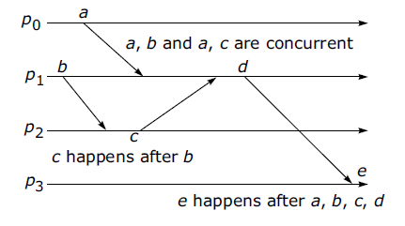
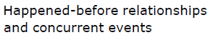
Event ordering
Logical Clocks
Processes exchanges messages: if not then concurrent
Sent and received messages
Happened before relation Causal ordering

Slide 11
Lamport’s Idea of Logical Clocks
Processes that don't interact don't matter (need a common clock)
Event ordering is key, rather than true time
Absolute correctness is less important than consistency (logical versus physical clocks)

Slide 12
Implementation of Logical Clocks
Conditions for correct functioning: timestamp C(e) for event e
C1: If a and b are two events in the same process, and a→ b, then we demand that C(a) < C(b).
C2: If a corresponds to sending a message m, and b corresponds to receiving that message, then also C(a) < C(b).
C3: A clock C associated with the process P must always go forward, never backwards. Hence corrections to a logical clock must be always made by adding a positive value, never subtracting from it.

Slide 13
Lamport’s Implementation Rules
IR1:
Each process P increments C by any two successive events. This IR ensures that condition C1 is satisfied.
IR2:
If event a is sending of a message m by process P, the message m contains a timestamp Tm- C(a) and upon receiving the message m by another process P, it sets its clock C to a value greater or equal to its present value but greater than Tm. This IR ensures that condition C2 is met.

Slide 14
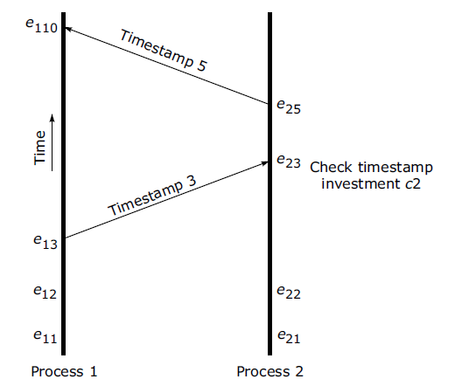
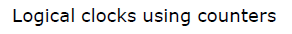
Implementation Using Counters

Slide 15
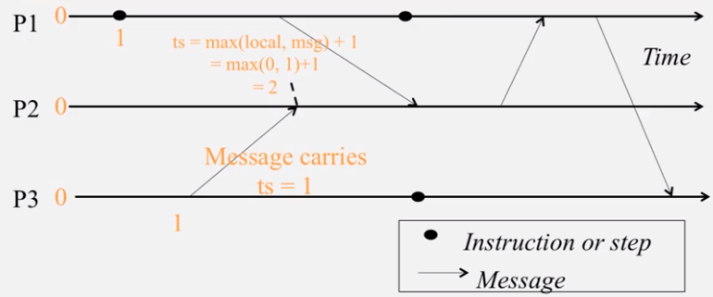
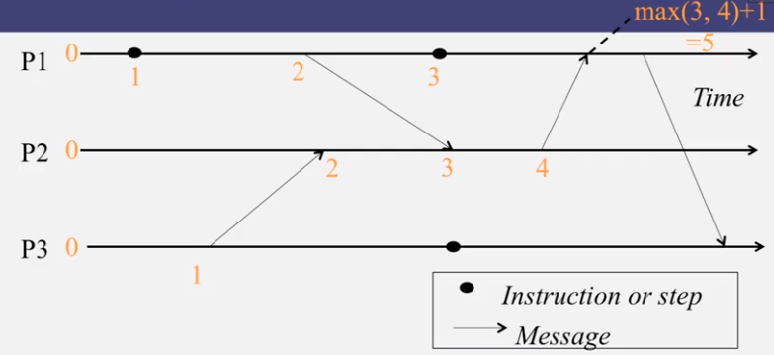
Lamport timestamps

Slide 16
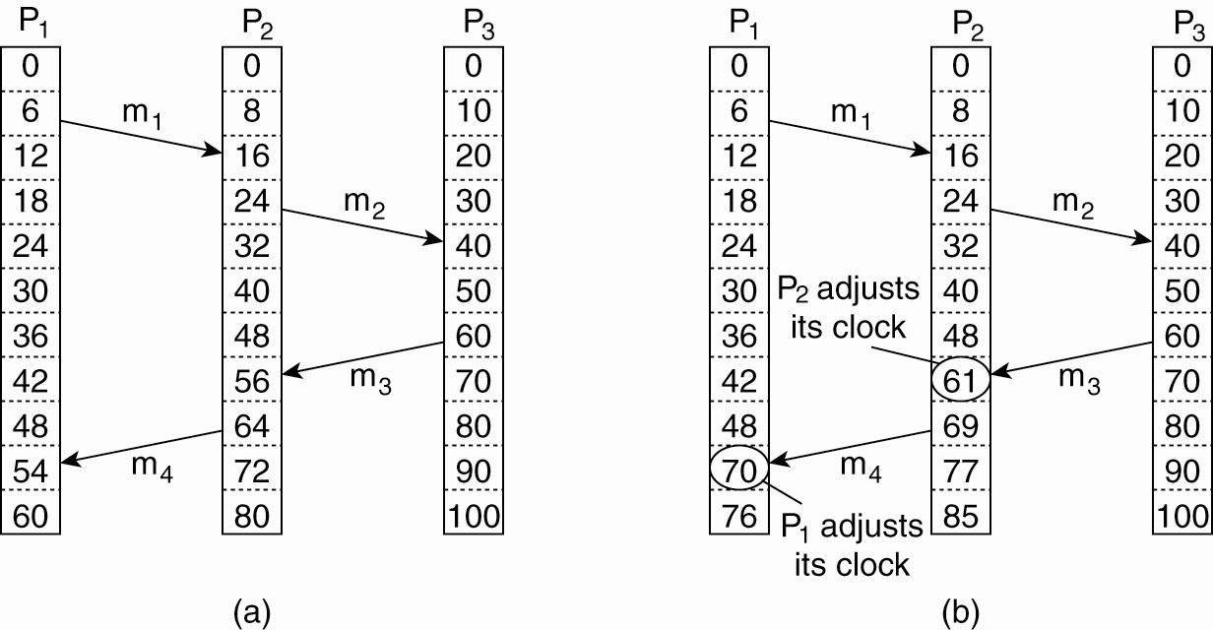
Lamport’s Logical Clocks (2)
Figure 6-9. (a) Three processes, each with its own clock. The clocks run at different rates.

Slide 17
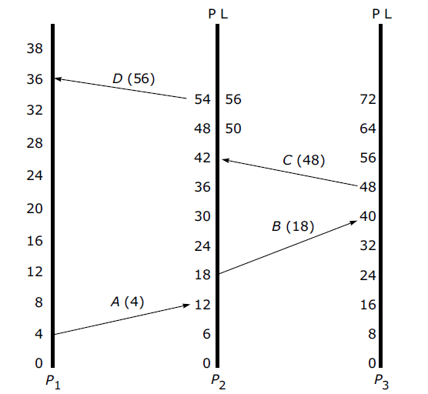
Lamport’s Logical Clocks (3)
Figure 6-9. (b) Lamport’s algorithm corrects the clocks.

Slide 18
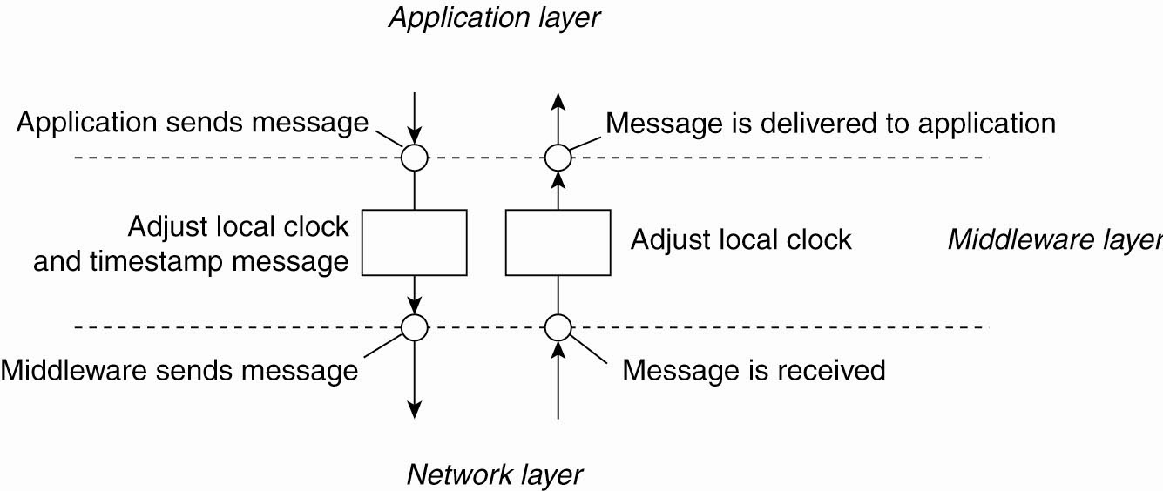
Lamport’s Logical Clocks (4)
Figure 6-10. The positioning of Lamport’s logical clocks in distributed systems.

Slide 19
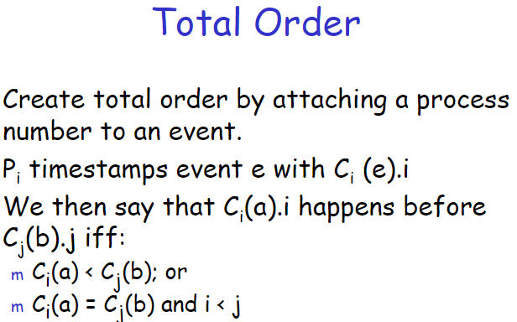
Total Ordering of Events
Happened before: partial ordering
Events may have same timestamp
Total ordering:
(time + order of events)
No two events should occur at exactly same time.
Soln: P1 and P2 TS 20 then 20.1 for P1 20.2 for P2.
Conditions for assigning time :
If a happens before b in the same process P, then C(a)< C(b)
If a and b represent the sending and receiving of a message, then C(a)< C(b)
For all distinct events a and b, C(a) not = C(b)

Slide 20
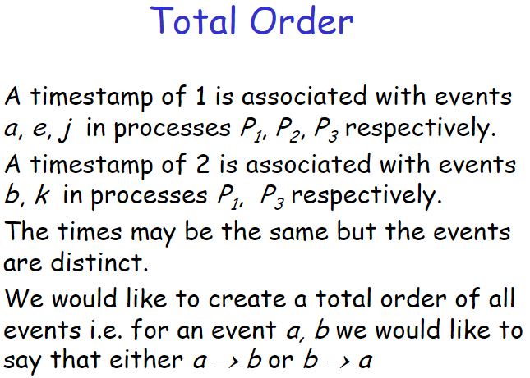
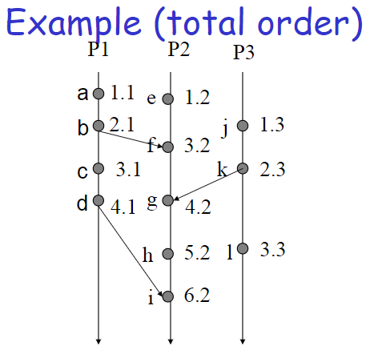

Slide 21
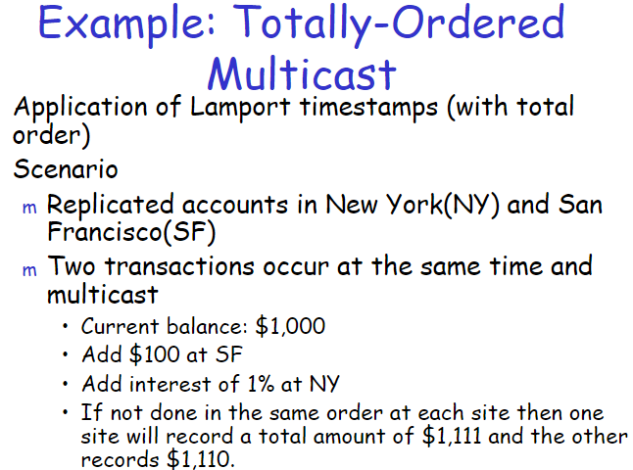
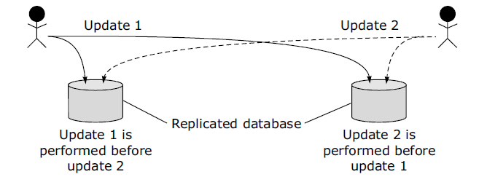

Slide 22
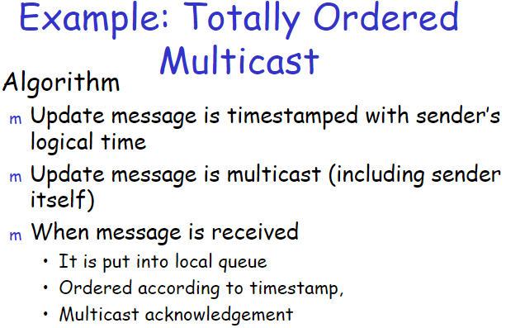
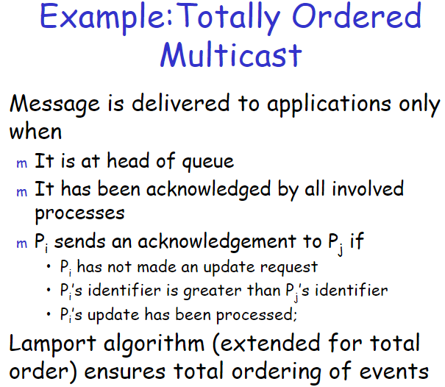

Slide 23
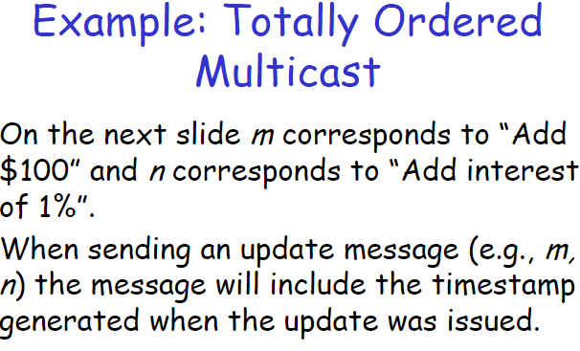
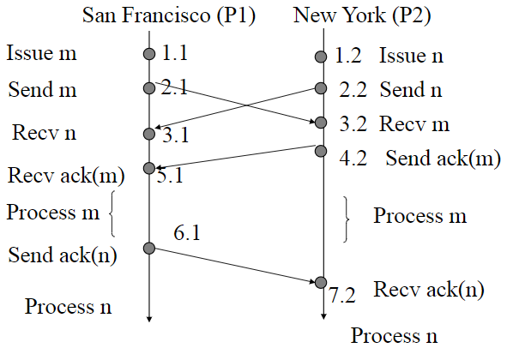

Slide 24
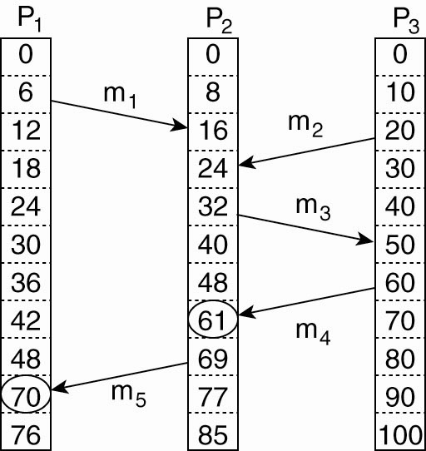
Vector Clocks (1)
Lamport: relationship between a and b can’t be said by comparing C(a) and C(b)
Tsend(mi)<Trecv(mi)
Trecv(mi)<Tsend(mj)?
mi=m1 and mj=m3 process P2
16<32
16<20 but
no relation between sending of m2 and reception of m1
If m2 is received after m1 that does not mean its reply for m1.
Problem: Lamport do not capture casuality
Figure 6-12. Concurrent message transmission using logical clocks.

Slide 25
Vector Timestamps
Causality is captured by Vector timestamps
Vector clocks are constructed by letting each process P_{i} maintain a vector VC_{i} with the following two properties:
VC_{i} [ i ] is the number of events that have occurred so far at P_{i}. In other words, VC_{i} [ i ] is the local logical clock at process P_{i} .
If VC_{i} [ j ] = k then P_{i} knows that k events have occurred at P_{j}. It is thus P_{i}’s knowledge of the local time at P_{j} .

Slide 26
Vector Clocks
Before executing an event P_{i} executes VC_{i} [ i ] ← VC_{i} [i ] + 1.
When process P_{i} sends a message m to P_{j}, it sets m’s (vector) timestamp ts (m) equal to VC_{i} after having executed the previous step.
Upon the receipt of a message m, process P_{j} adjusts its own vector by setting VC_{j} [k ] ← max{VC_{j} [k ], ts (m)[k ]} for each k, after which it executes the first step and delivers the message to the application.

Slide 27
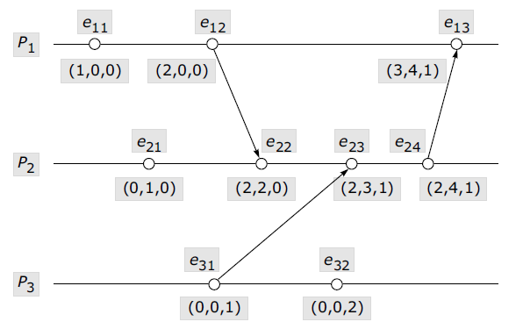
Vector Timestamps Contd.

Slide 28
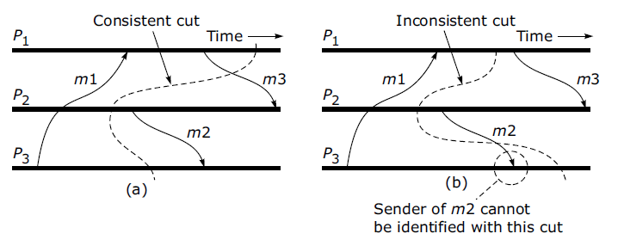
Global State
Global state: local state of each process+ messages in transit
Analysing : Deadlock or correctly terminate
Recording global state
By Chandy and Lamport
Recording global state ( current state )
Termination detection

Slide 29
Mutual Exclusion
N processes share a single resource
Safety: only one process can access shared resource at a time
Liveness: if a process requests to access the shared resource, it should eventually be given chance to do so
In DS ME is complex as:
No shared memory
Delay in information propagation
Clock synchronization issues
Need for event ordering
Algorithms:
Centralized Algorithm
Distributed Algorithm
Token Ring Algorithm

Slide 30
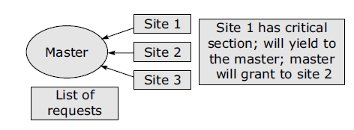
Centralized Mutual Exclusion Algorithm
Messages used
Request-R
Grant-G
Release-R

Slide 31
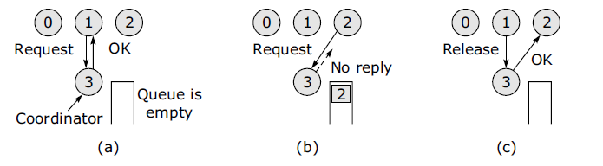
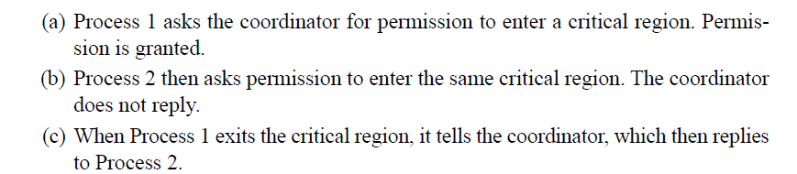
Centralized Algorithm Execution
Problems:
Single point of failure
Single coordinator becomes performance bottleneck

Slide 32
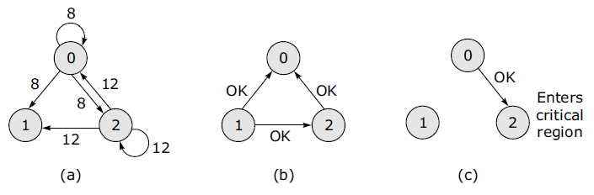
Distributed Algorithm Execution: Ricart and Agrawala’s
Total ordering: message(CS, PID, TS)
Process with lowest TS wins
Three cases:
Receiver not in CS and does not want to enter sends OK (Node 1)
If receiver is in CS, it does not reply and queues the request
If receiver (Node 0 and 2) wants to enter CS but not yet done so, it compares received TS with its own message, lower one wins.
If message has low TS, Receiver sends OK to sender (Node 2 to Node 0) else queues the request and sends nothing
Problems:
NO distinguish between dead coordinator & ‘denied’

Slide 33
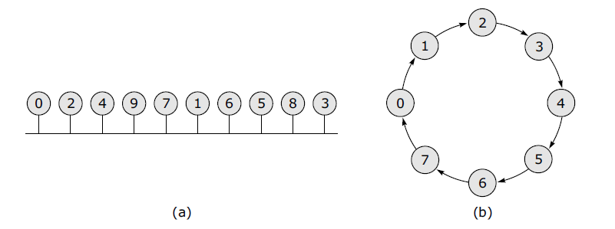
Token Ring Algorithm Execution
No inherent ordering
Logical ring over a bus network: numerical order
Ring initialized, Process 0 given a token
When process has token it can enter CS
Upon exiting it will pass token to next
Only 1 process with token in CS
No starvation
Problems:
Detecting loss of token(2 hrs)

Slide 34
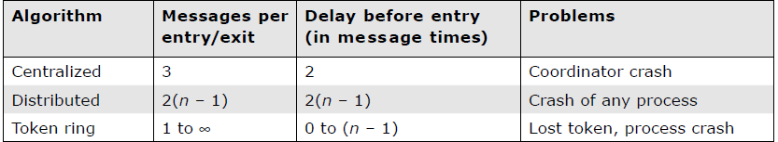
Comparison

Slide 35
Election Algorithms
Goals
Attempt to locate the process with the highest process number and designate it as the coordinator and tell all the active processes about this coordinator
To allow a recovered leader to re-establish control (or at least, to identify the current leader)
Assumptions: All processes:
Process ID, total ordering, agree on new coordinator,know other process numbers, hold an election
Algorithms
Bully algorithm
Ring algorithm

Slide 36
Election Algorithms
The Bully Algorithm
P sends an ELECTION message to all processes with higher numbers.
If no one responds, P wins the election and becomes coordinator.
If one of the higher-ups answers, it takes over. P’s job is done.

Slide 37
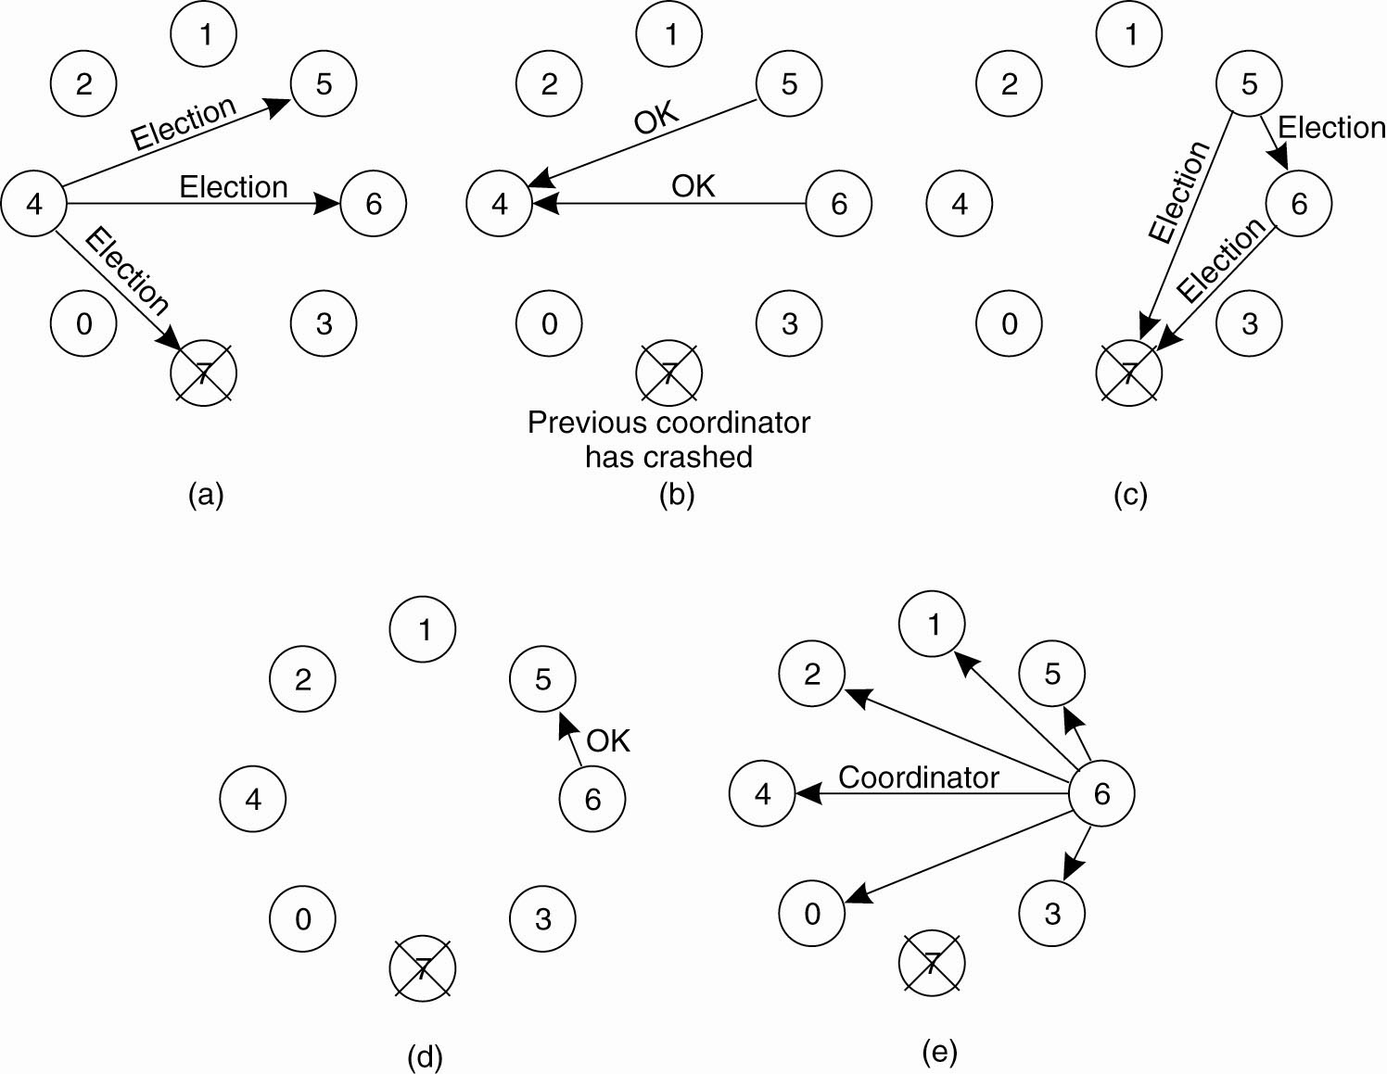
The Bully Algorithm (1)
Figure 6-20. The bully election algorithm. (a) Process 4 holds an
election. (b) Processes 5 and 6 respond, telling 4 to stop.
(c) Now 5 and 6 each hold an election.

Slide 38
The Bully Algorithm (2)
Figure 6-20. The bully election algorithm. (d) Process 6 tells 5 to stop. (e) Process 6 wins and tells everyone.

Slide 39
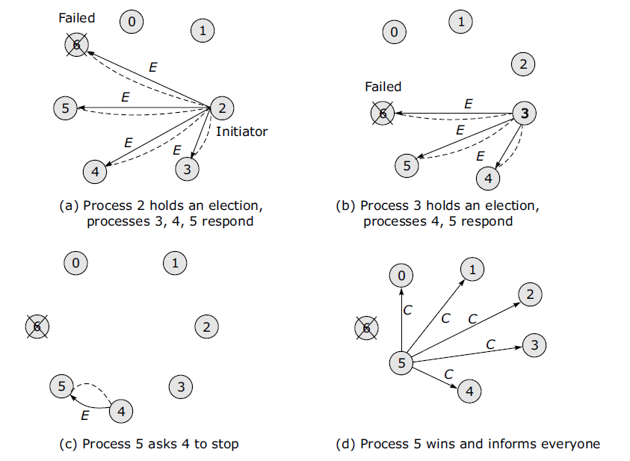
Bully Algorithm - Example
0

Slide 40
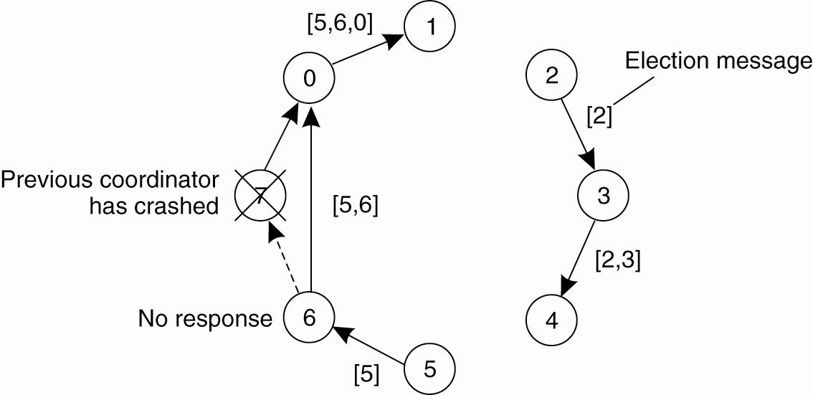
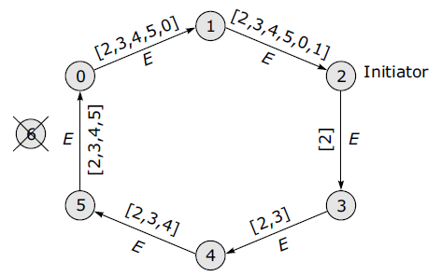
Token Ring Algorithm
Messages
Election (E)—announce an election, is token message
Coordinator ( C) — announce new coordinator

Slide 42
Distributed Mutual Exclusion:
Lamport’s distributed algorithm:
permission based timestamp to order critical section requests and to resolve any conflict between requests.
critical section requests are executed in the increasing order of timestamps i.e a request with smaller timestamp will be given permission to execute critical section first than a request with larger timestamp.

Slide 43
Three type of messages ( REQUEST, REPLY and RELEASE) are used and communication channels are assumed to follow FIFO order.
A site send a REQUEST message to all other site to get their permission to enter critical section.
A site send a REPLY message to requesting site to give its permission to enter the critical section.
A site send a RELEASE message to all other site upon exiting the critical section.
Every site S_{i}, keeps a queue to store critical section requests ordered by their timestamps. request_queue_{i} denotes the queue of site S_{i}
A timestamp is given to each critical section request using Lamport’s logical clock.
Timestamp is used to determine priority of critical section requests. Smaller timestamp gets high priority over larger timestamp. The execution of critical section request is always in the order of their timestamp.

Slide 44
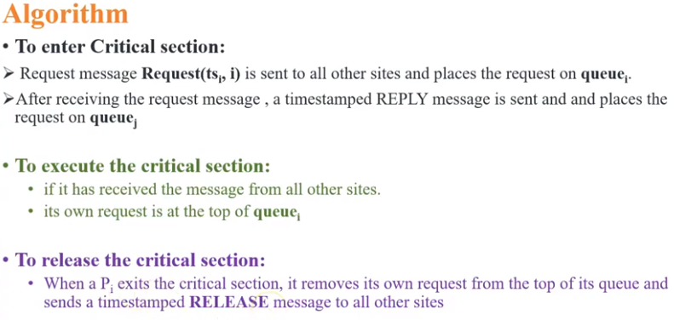

Slide 45
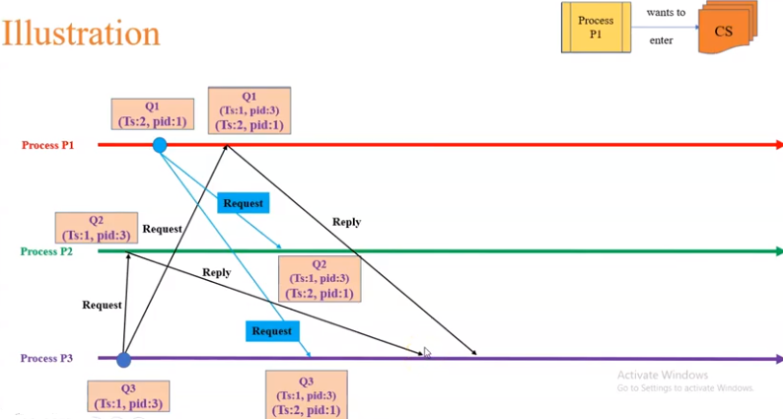
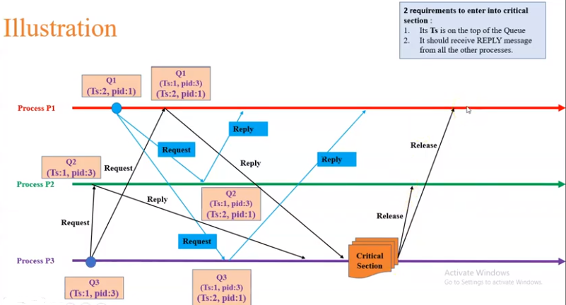

Slide 46
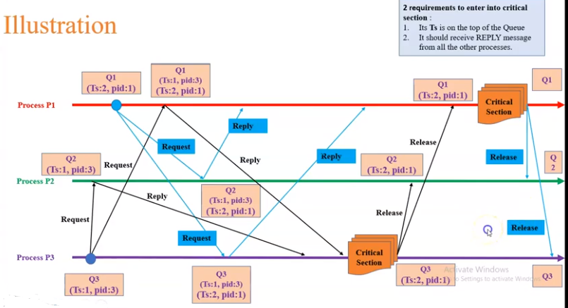

Slide 47
Ricart Agrawala
Extension and optimization of Lamport’s Distributed Mutual Exclusion Algorithm.
Two type of messages ( REQUEST and REPLY) are used and communication channels are assumed to follow FIFO order.
A site send a REQUEST message to all other site to get their permission to enter critical section.
A site send a REPLY message to other site to give its permission to enter the critical section.
A timestamp is given to each critical section request using Lamport’s logical clock.
Timestamp is used to determine priority of critical section requests. Smaller timestamp gets high priority over larger timestamp. The execution of critical section request is always in the order of their timestamp.

Slide 48
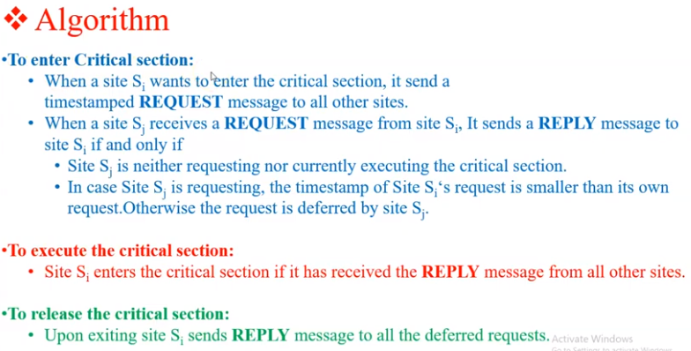

Slide 49
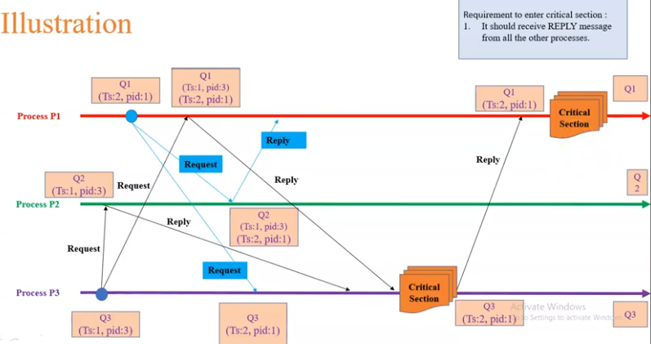

Slide 50
As we know, In permission based algorithms like Lamport’s Algorithm, Ricart-Agrawala Algorithm etc. a site request permission from every other site but in quorum based approach, A site does not request permission from every other site but from a subset of sites which is called quorum.
Three type of messages ( REQUEST, REPLY and RELEASE) are used.
A site send a REQUEST message to all other site in its request set or quorum to get their permission to enter critical section.
A site send a REPLY message to requesting site to give its permission to enter the critical section.
A site send a RELEASE message to all other site in its request set or quorum upon exiting the critical section.

Slide 51
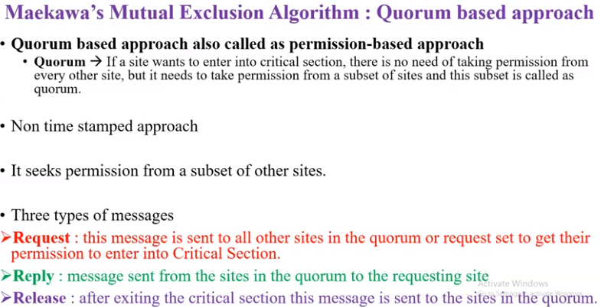

Slide 52
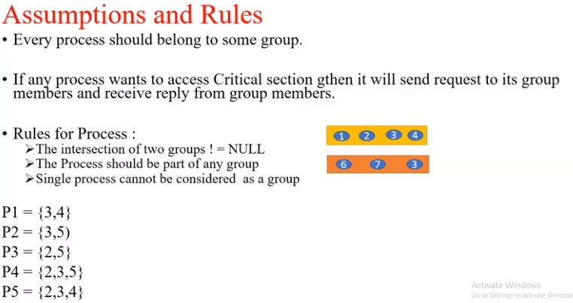

Slide 53
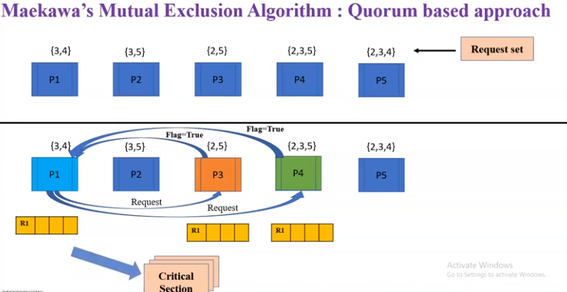

Slide 54
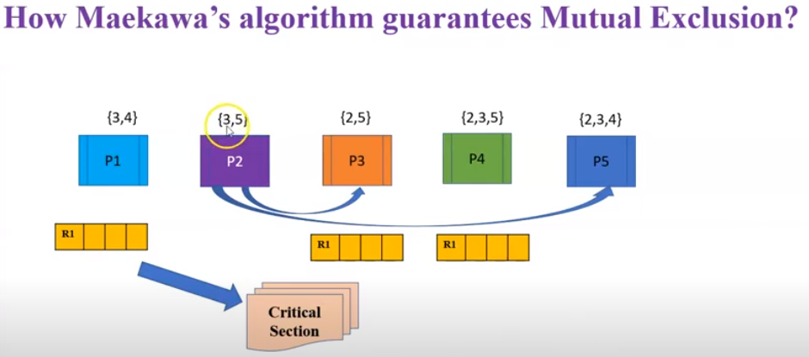
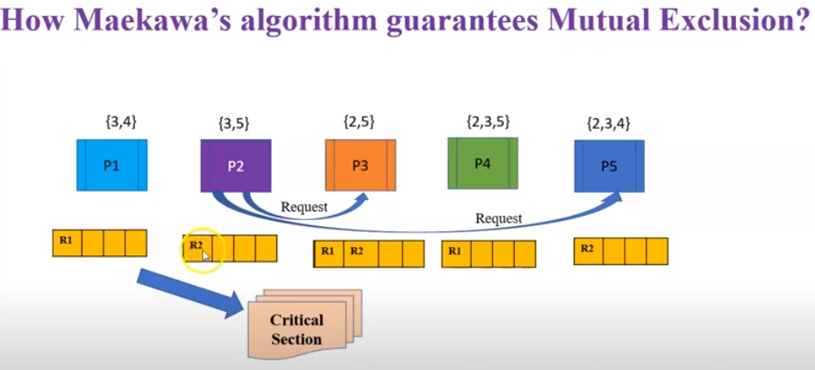

Slide 55



Slide 56


Slide 57


Slide 58
End of Synchronization

Slide 59
Mutual exclusion
Requirements:
Safety : at most 1 process in CS
Liveness: process requesting CS should be granted. No deadlock or starvation.
Fairness: each process should get fair chance to execute in CS
Performance metrics:
Synchronization delay(SD): time between CS exit and new entry
System throughput(ST): rate of CR requests execution
Message complexity(MC): No. of messages required per CS execution
Response time(RT): interval between request sent and execution completed.
ST=1/SD+E (E is average CS execution time)

Slide 60


Slide 61

Performance parameters

Slide 63
Comparison
Bully algorithm
N–2 messages in best case
O(N²) messages in worst case
Ring algorithm
3N–1 messages in worst case
N–1 election messages to reach immediate neighbour in wrong direction, N election messages to elect it, then N elected messages to announce result

Slide 64
Deadlocks in Distributed Systems
Basic concepts
Resources
Preemptable resources
Non-preemptable resources
Sequence of events: request, allocate, and release
Request →Allocate →Use →Release

Slide 65
Distributed Deadlocks
Types
Communication deadlocks
Resource deadlocks
Necessary and sufficient conditions for deadlock to occur
Mutual exclusion condition
Hold and wait condition
No preemption condition
Circular wait condition

Slide 66


Concept of Cycle

Slide 67
Deadlock Modelling
Basic terminologies
Directed graphs
Path
Cycle
Reachable set
Knot

Slide 68

Directed Graph
Also called a Resource Allocation Graph (RAG)
Nodes
Edges

Slide 69


Directed Graph Contd.

Slide 70

Elements of RAG
Process node
Resource node
Assignment edge
Request edge

Slide 71


RAG

Slide 72

RAG Example

Slide 73


State Transition Rules
Request
Acquisition
Release

Slide 74




Necessary and Sufficient Conditions in RAG

Slide 75


Wait For Graph : WFG-1

Slide 76
Wait For Graph : WFG-2
If graph contains no cycles ⇒ no deadlock
If graph contains a cycle ⇒
if only one instance per resource type, then deadlock
if several instances per resource type, possibility of deadlock

Slide 77
Handling Deadlock in Distributed Systems
The ostrich algorithm (ignore the problem, most common approach)
Avoidance (avoid deadlocks by allocating resources carefully)
Prevention (make deadlocks structurally impossible)
Detection (let deadlocks occur, detect them, and then try to recover)

Slide 78


Deadlock Avoidance-1

Slide 79

Deadlock Avoidance-2

Slide 80

Another Example of Resource Allocation

Slide 81

Safe Allocation

Slide 82

Unsafe Allocation

Slide 83
Distributed Deadlock Prevention
Collective requests (denies the hold and wait condition)
Ordered requests (denies the circular wait condition)
Preemption (denies the no preemption condition)

Slide 84
Schemes for Killing Transactions
Wait-die
Wound-wait

Slide 85

Wait-die
If an old process wants a resource held by a young process, the old one will wait.
If a young process wants a resource held by an old process, the young process will be killed.

Slide 86

Wound-wait
If an old process wants a resource held by a young process, the old one will preempt the young process -- wounded and killed, restarts and wait.
If a young process wants a resource held by an old process, the young process will wait.

Slide 87
Deadlock Detection Techniques
Centralized control
Hierarchical control
Distributed control

Slide 88
Centralized Control
Local deadlock
Global WFG
Message transfer
Continuous transfer
Periodic transfer
Transfer on request

Slide 89


False Deadlock

Slide 90
Distributed Deadlock Detection
WFG based distributed approach
Probe based distributed algorithm

Slide 91
Distributed Deadlock Recovery
Recovery through preemption
Recovery through rollback
Recovery through killing processes

Slide 92
Issues in Recovery from Deadlock
Selection of victims
Minimization of recovery costs
Prevention of starvation
Use of transaction mechanism

